Slide 1
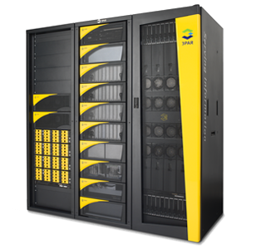
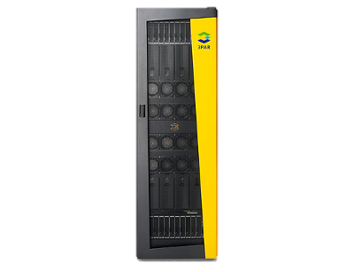
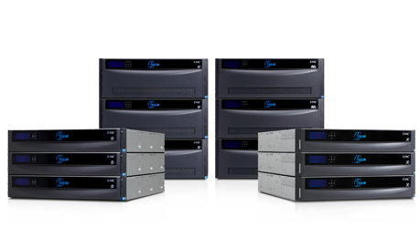
Storage Technologies
Telerik Software Academy
academy.telerik.com
Storage Networks and Storage Devices
Borislav Varadinov
Marian Marinov
System Administrator
CEO of 1H Ltd.
bobi@itp.bg
mm@1h.com

Slide 2


Table of Contents
What Is Direct Attached Storage?
What Is a Storage Area Network?
What is Fibre Channel?
Other Storage Networks
What Is Network Attached Storage?
What Is the Difference Between a SAN and a NAS?

Slide 3
What Is Direct Attached Storage?
Direct-attached storage is the most basic level of storage, in which storage devices are part of the host computer or directly connected to it.
ATA (Advanced Technology Attachment)
SATA (Serial Advanced Technology Attachment)
eSATA
SCSI (Small computer system interface)
SAS (Serial Attached SCSI)
USB
FireWare

Slide 4


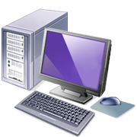

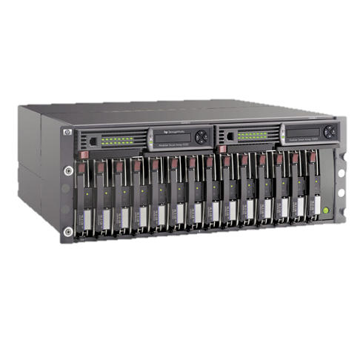
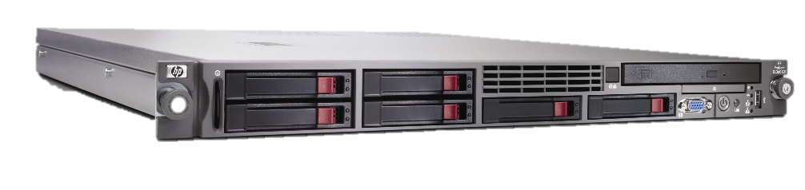

DAS
LAN

Slide 5


DAS Advantages and Disadvantages
Advantages
Easy to configure
Inexpensive
Disadvantages
Isolated to a small number of servers (2-4)
Small capacity (8 – 12 Disks)
Slower

Slide 6
What Is a Storage Area Network?
A Storage Area Network (SAN) is a dedicated storage network that provides central access to block level data storage devices.
Provides block-based storage and leaves file system concerns on the "client" side
Primarily used to access disk arrays and tape libraries
The devices appear like locally attached devices to the operating system
Offers storage high availability and flexibility
Most SAN networks rely on the SCSI protocol for communication between servers and disk drive devices

Slide 7
What is Fibre Channel?
Fibre Channel (FC) is a multi-layered network that define characteristics and functions for moving data across the network.
Fibre Channel Protocol (FCP) transmits SCSI commands over the FC network
FC is the most used SAN communication standard
FC was originally designed to support only fiber optic cabling
Twisted-pair copper support is added later
FC architecture includes a significant amount of hardware processing to deliver high performance
Notes:
In addition to being a physical transport, SCSI is also a protocol. This protocol specifies
commands and controls for sending blocks of data between the host and the attached
devices. SCSI commands are issued by the host operating system, in response to user
requests for data

Slide 8
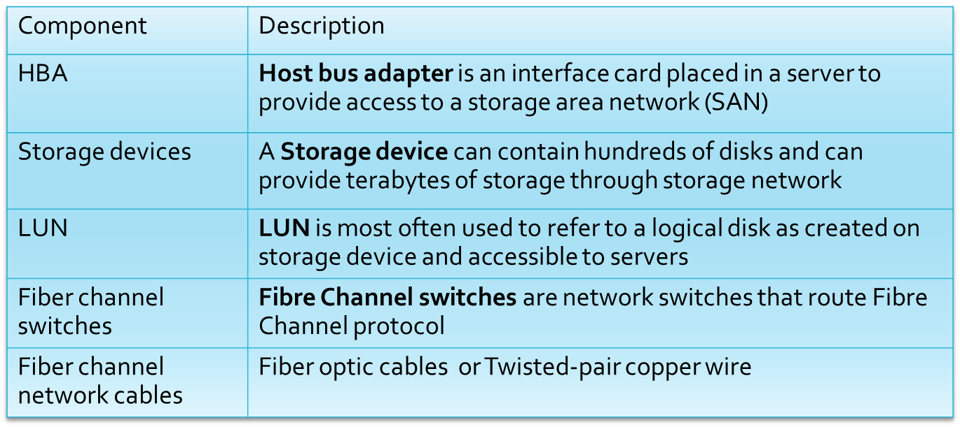
Fiber Channel Components

Slide 9
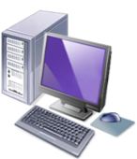

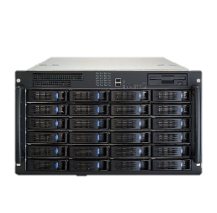
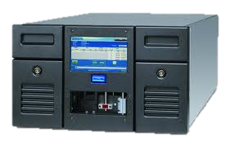
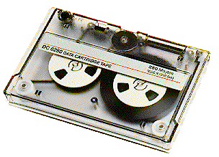
SAN
Clients
TCP/IP Network
Servers
File Systems – NTFS/Ext3/FAT/XFS
Storage Area Network
Storage
Devices

Slide 10


SAN Advantages and Disadvantages
Advantages
Centralized storage for many servers
Fastest access times
Easily expandable and flexible
High level of redundancy and high availability
Disadvantages
More/Very expensive
Complicated Solution
Requires specialized skills and trained experts

Slide 11
Other Storage Networks
iSCSI
  Transmits SCSI commands over standard Internet Protocol (TCP/IP) networks
FCoE (Fibre Channel over Ethernet)
  Encapsulation of Fibre Channel over Ethernet
AOE (ATA over Ethernet)
  Encapsulation of ATA protocol over Ethernet
HyperSCSI
  Encapsulation of SCSI over Ethernet

Slide 12
What Is Network Attached Storage?
NAS is a central network storage accessed through a standard computer network (TCP/IP) and high-level protocol
Offers centralized storage at an affordable price
Often manufactured as a computer appliance
Uses file-level access protocols (NFS,SMB)
Can be created easily with standard Linux or Windows server
Some NAS appliances offer SAN communication through FCP or iSCSI

Slide 13


NAS Advantages and Disadvantages
Advantages
Easy to configure
Relatively inexpensive
Used in many business scenarios
Centralized storage for many servers and workstations
Disadvantages
Slower access times
Not a real enterprise solution for high I/O applications

Slide 14
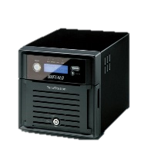
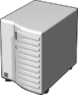
What Is the Difference Between NAS and SAN?
Clients
Clients and Servers
TCP/IP Network
NFS or SMB Client
File Level Access
Servers
File Systems – NTFS/Ext3/FAT/XFS
TCP/IP Network
Block Level Access
Storage Area Network
NFS or SMB Server
NAS
Devices
File Systems – NTFS/Ext3
Storage
Devices

Slide 15
Storage Networks and Storage Devices
http://academy.telerik.com

Slide 16




Free Trainings @ Telerik Academy
"Web Design with HTML 5, CSS 3 and JavaScript" course @ Telerik Academy
    html5course.telerik.com
  Telerik Software Academy
    academy.telerik.com
  Telerik Academy @ Facebook
    facebook.com/TelerikAcademy
  Telerik Software Academy Forums
    forums.academy.telerik.com

